Slide 1

Introduction to probability
DATA ANALYTICS | IRONHACK

Slide 2

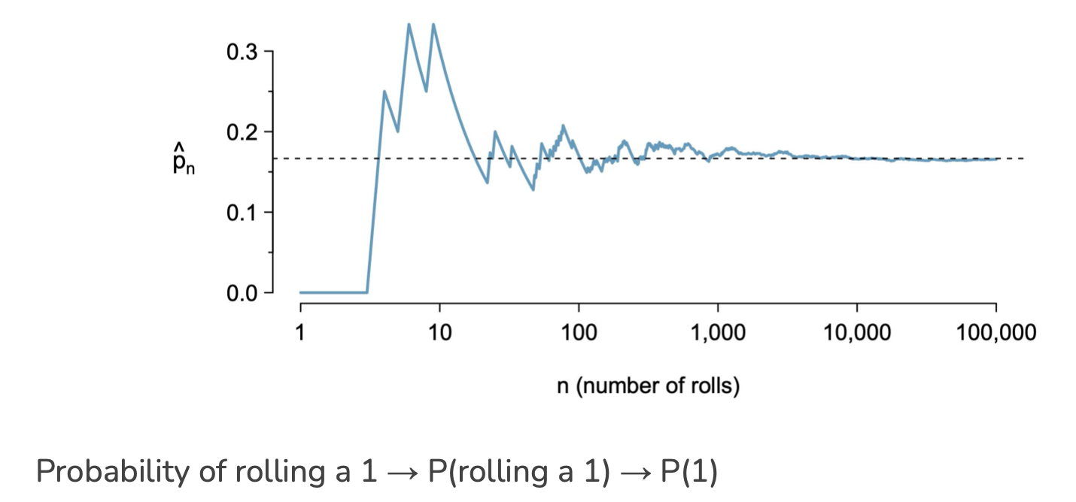
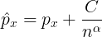
IRONHACK BOOTCAMP
EVENTS AND PROBABILITY
The probability of an outcome is the proportion of times that the outcome will occur if we observe the random process an infinity amount of times

Slide 3
IRONHACK BOOTCAMP
COMBINING PROBABILITIES
Two different events can be broadly classified as:
Joint -> They can happen together
Disjoint -> They can’t happen together
Combination rules for probabilities are different for join and disjoint events:
A coin and you have dice

Slide 4

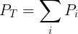
IRONHACK BOOTCAMP
COMBINING PROBABILITIES: DISJOINT EVENTS
To compute the probability of two disjoint events, we add the probabilities of each of them:
P(A U B)= P (A) + P(B) - P (A and B)

Slide 5

IRONHACK BOOTCAMP
COMBINING PROBABILITIES: JOINT EVENTS
To compute the probability of two joint events, we add the probabilities of each of them but subtracting the intersections:

Slide 6
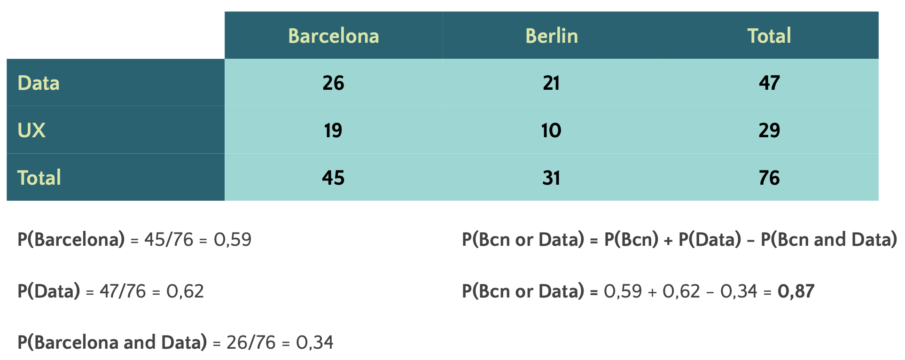
IRONHACK BOOTCAMP
EXAMPLES

Slide 7


